Slide 1
KnightBites
David Barry, Kenny Howes,
Lujia Li, Peter Lund, Lily McAboy, Jacob Tocila
Notes:
Peter (Slides)

Slide 2

The Vision
Platform to make informed meal choices.
Dining halls adjust offerings based on feedback
Improves campus dining experience through real-time feedback.
Notes:
David

Slide 3
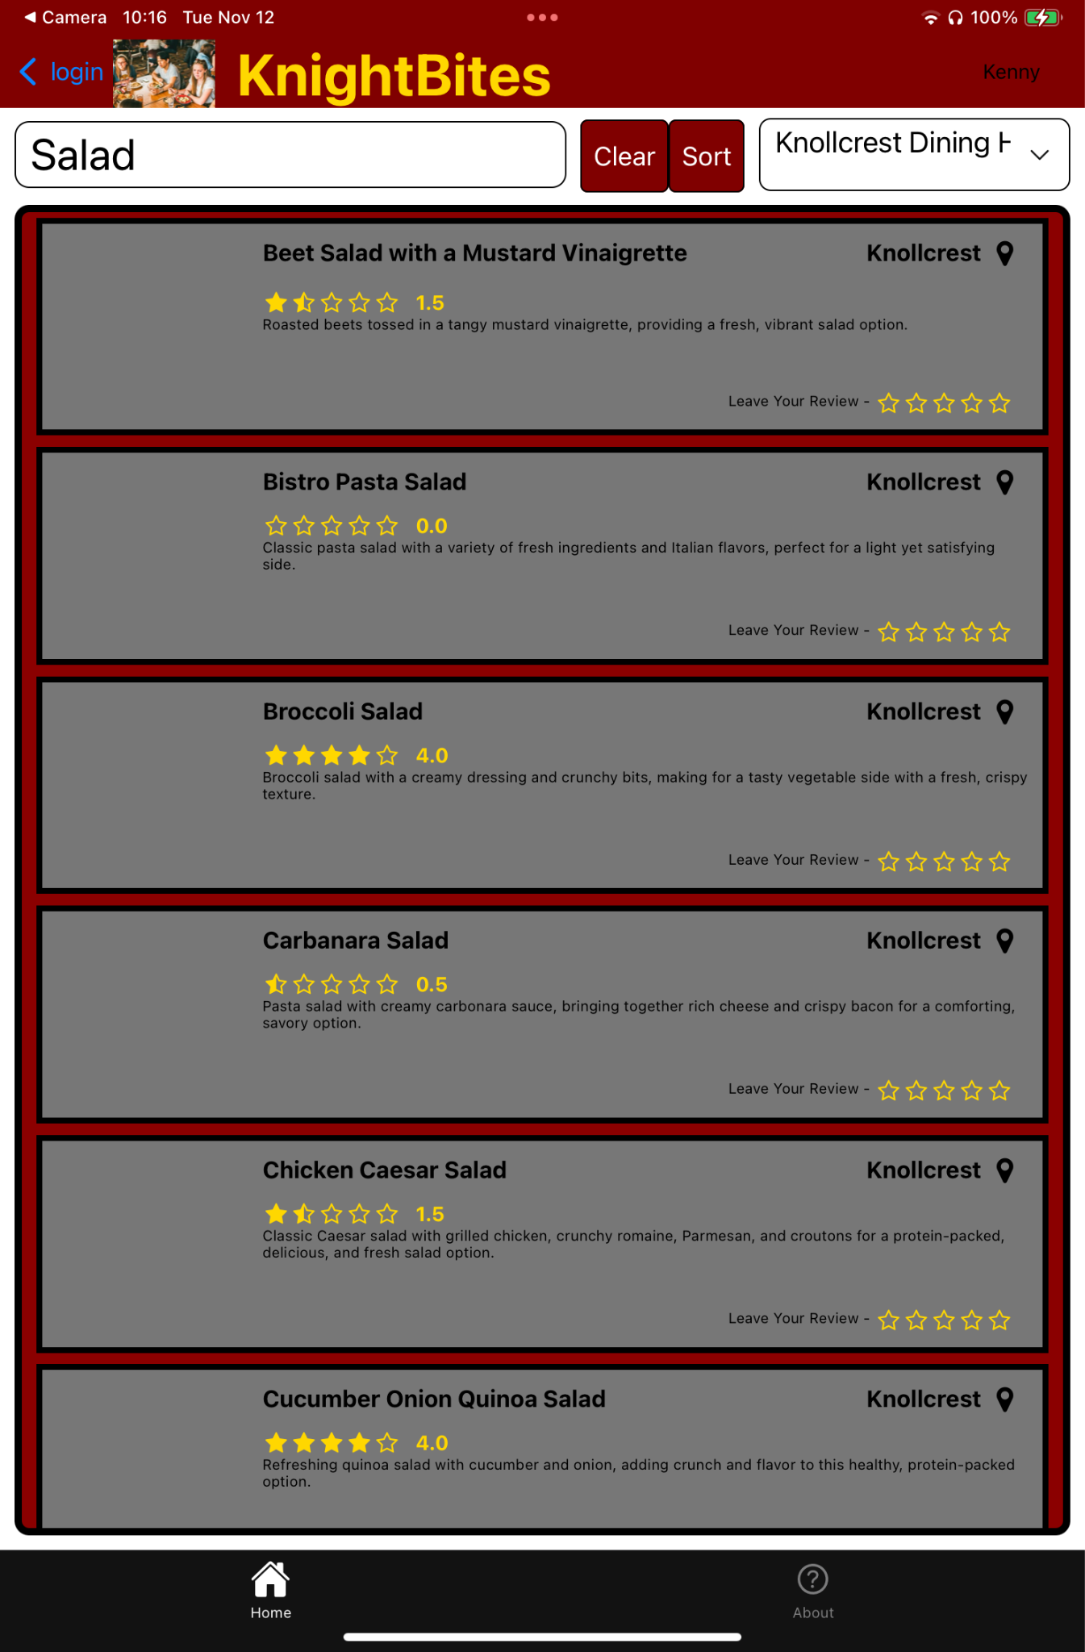
Demonstration
With online help!
Notes:
Lily (narration)
Lujia (operator)

Slide 4
Technologies
Notes:
Kenny

Slide 5
React Native
Mobile app development framework
Component based architecture
Less time rewriting same code

Slide 6
Azure
Service
Web service
Node.js 20 stack
Proxies database with REST API
Database
PostgreSQL DBMS
Schema based on domain model

Slide 7
Design
Notes:
Kenny

Slide 8
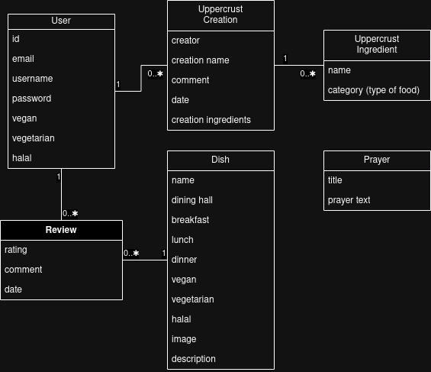
Information System
Relational database
Supports the 3 major “applets”
Centered around user
Notes:
As we’ve seen throughout the demo…
one user can have many ratings and comments for one dish.
one dish can have many ratings and comments from many users.

Slide 9
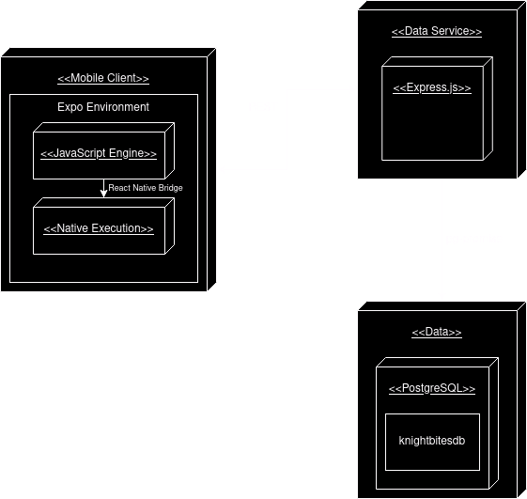
Deployment Diagram
Keeps database separated
Utilize HTTP(S) infrastructure

Slide 10
Assessment
Notes:
Jacob

Slide 11
Strengths & Weaknesses
Strengths
Strong data and service
User subsystem
Multipurpose app
Food ranking
Sandwich sharing
Prayers
Weaknesses
Database changes don’t update in real time
Ethical implications
Notes:
Strengths:
Strong data & service
We have made almost 600 food cards for dishes served from Calvin’s dining halls.
User subsystem
Every user’s profile data is securely stored in our database.
Users can easily change their email, password, and dietary restrictions associated with their account
KnightBites
Users can browse dishes and write reviews for them OR
Create a sandwich based on Calvin’s UpperCrust dining hall and share them
Weaknesses:
Database changes don’t update in real time.
There is a small delay when reviews are posted.
For example, the overall score of a dish gets updated daily at midnight.
This can be fixed with a more pricey database plan
Ethical implications
Go to next slide

Slide 12
Social/Ethical Implications
Ethical Implications
How does this affect Calvin Dining Services staff?
Does this affect allergen friendly, cultural, or unpopular foods?
Aren’t dishes more than 1-5 stars?
Postman
Idea #1: Technology giveth and technology taketh away
Idea #3: Embedded in every technology is a philosophy.
“Five Things We Need to Know About Technological Change” by Neil Postman talk delivered in Denver Colorado March 28, 1998
Notes:
Ethical implications:
How does this affect Calvin Dining Services staff?
Feedback is helpful, but too much negative feedback could be overwhelming
Does this affect allergen friendly, cultural, or unpopular foods?
Certain dishes could be review bombed, potentially getting special dishes removed.
Postman:
Idea #1: Technology taketh and given away
KnightBites enhances food awareness and aims to reduce waste, but may unintentionally get dishes removed
Idea #4: Technology is not just additive, it’s ecological
With this app, students aren’t just eating at the dining halls, they are eating with the mind of a critic, potentially changing how they rate their food

Slide 13
Future Work
Functionality
Expand dietary restrictions
Dairy/gluten free, etc.
Large database rework
More voting power to people with dietary restrictions
Future Hopes
Partner with Calvin Dining Services database
Real feedback, real change
Notes:
Functionality:
Expand dietary restrictions
Dairy/gluten free, etc.
More voting power to people with dietary restrictions
A more unified image collection?????
Future Hopes:
Partner with Calvin Dining Services
So that we can give real feedback and have real change in the dining halls

Slide 14
Changes From Usability Tests
Advanced search and filtering options
Greater sorting features
Better UpperCrust user interface
FAQ page with helpful tips
Prayer Page implemented
With special prayers from devs
Notes:
Advanced search and filtering options
Users can now sort by dining hall, mealtime, & dietary restrictions
FAQ page with helpful tips
Easier access per request from users
Prayer Page implemented
Started as a joke, but we added a page to give you a prayer before you eat
And with that, let’s go ahead and move onto any questions from the audience…

Slide 15
Questions

